Slide 1
MIPS
Instruction Set Architecture
19CSE211 COA
Session 8
29-01-2021

Slide 2
Instructions
Load and store instructions
Example:
C code: A[8] = h + A[8];
MIPS code: ????
Store word operation has no destination (reg) operand
Remember arithmetic operands are registers, not memory!
H.C. TD5102

Slide 3
Instructions
Load and store instructions
Example:
C code: A[8] = h + A[8];
MIPS code: lw $t0, 32($s3)
add $t0, $s2, $t0
sw $t0, 32($s3)
Store word operation has no destination (reg) operand
Remember arithmetic operands are registers, not memory!
H.C. TD5102

Slide 4
So far we’ve learned:
MIPS
— loading words but addressing bytes
— arithmetic on registers only
Instruction Meaning
add $s1, $s2, $s3
sub $s1, $s2, $s3
lw $s1, 100($s2)
sw $s1, 100($s2)
H.C. TD5102

Slide 5
So far we’ve learned:
MIPS
— loading words but addressing bytes
— arithmetic on registers only
Instruction Meaning
add $s1, $s2, $s3 $s1 = $s2 + $s3
sub $s1, $s2, $s3 $s1 = $s2 – $s3
lw $s1, 100($s2) $s1 = Memory[$s2+100]
sw $s1, 100($s2) Memory[$s2+100] = $s1
H.C. TD5102

Slide 6
Machine Language
Instructions, like registers and words of data, are also 32 bits long
  Example: add $t0, $s1, $s2
  Registers have numbers: $t0=9, $s1=17, $s2=18
Instruction Format:
op rs rt rd shamt funct
000000 10001 10010 01000 00000 100000
6 bits
5 bits
5 bits
5 bits
5 bits
6 bits
H.C. TD5102

Slide 7
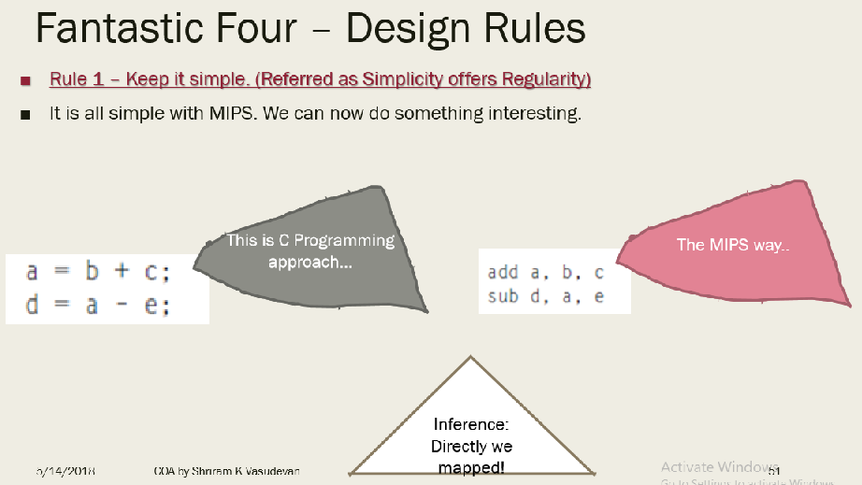
H.C. TD5102

Slide 8
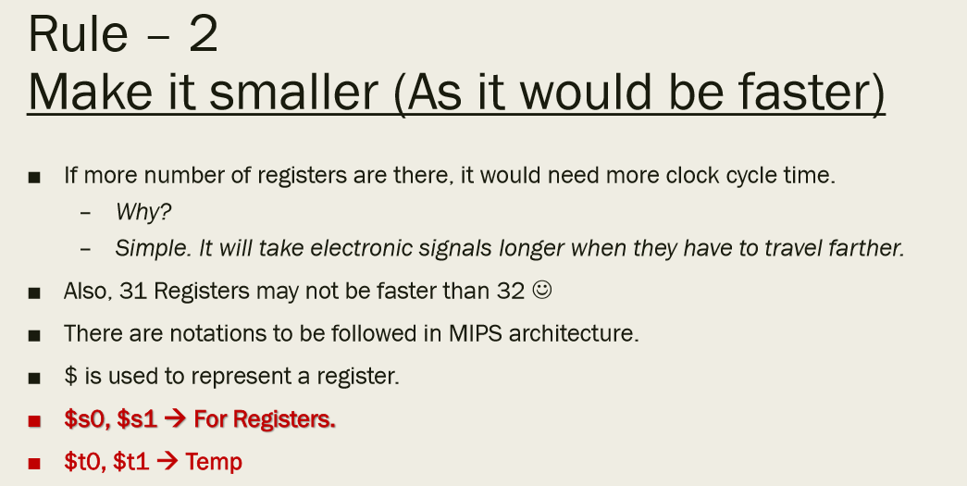
H.C. TD5102

Slide 9
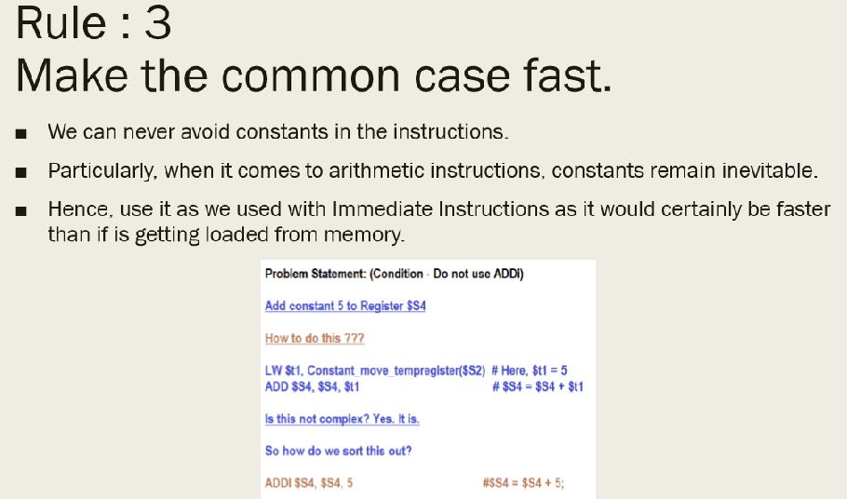
H.C. TD5102

Slide 10
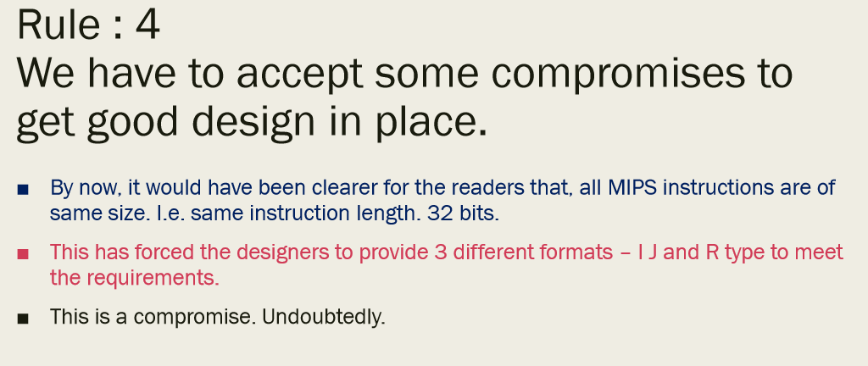
H.C. TD5102

Slide 11
Machine Language
Consider the load-word and store-word instructions,
  What would the regularity principle have us do?
  New principle: Good design demands a compromise
Introduce a new type of instruction format
  I-type for data transfer instructions
  other format was R-type for register
Example: lw $t0, 32($s2)
35 18 9 32
op rs rt 16 bit number
H.C. TD5102

Slide 12
Stored Program Concept
memory
OS
code
global data
stack
heap
Program 1
CPU
unused
Program 2
unused
H.C. TD5102

Slide 13
Control
Decision making instructions
  alter the control flow,
  i.e., change the "next" instruction to be executed
MIPS conditional branch instructions:
bne $t0, $t1, Label
beq $t0, $t1, Label
Example: if (i==j) h = i + j;
bne $s0, $s1, Label
add $s3, $s0, $s1
Label: ....
H.C. TD5102

Slide 14
Control
MIPS unconditional branch instructions:
j label
Example:
if (i!=j) beq $s4, $s5, Lab1
h=i+j; add $s3, $s4, $s5
else j Lab2
h=i-j; Lab1: sub $s3, $s4, $s5
Lab2: ...
Can you build a simple for loop?
H.C. TD5102

Slide 15
So far:
Instruction Meaning
add $s1,$s2,$s3 $s1 = $s2 + $s3
sub $s1,$s2,$s3 $s1 = $s2 – $s3
lw $s1,100($s2) $s1 = Memory[$s2+100]
sw $s1,100($s2) Memory[$s2+100] = $s1
bne $s4,$s5,L Next instr. is at Label if $s4 ° $s5
beq $s4,$s5,L Next instr. is at Label if $s4 = $s5
j Label Next instr. is at Label
Formats:
op rs rt rd shamt funct
R
I
J
op rs rt 16 bit address
op 26 bit address
H.C. TD5102

Slide 16
Control Flow
We have: beq, bne, what about Branch-if-less-than?
New instruction:
if $s1 < $s2 then
$t0 = 1
slt $t0, $s1, $s2 else
$t0 = 0
Can use this instruction to build "blt $s1, $s2, Label"
— can now build general control structures
Note that the assembler needs a register to do this,
— use conventions for registers
H.C. TD5102

Slide 17
Constants
Small constants are used quite frequently (50% of operands) e.g., A = A + 5;
B = B + 1;
C = C - 18;
Solutions? Why not?
  put 'typical constants' in memory and load them
  create hard-wired registers (like $zero) for constants like one
  or …….
MIPS Instructions:
addi $29, $29, 4
slti $8, $18, 10
andi $29, $29, 6
ori $29, $29, 4
H.C. TD5102
3

Slide 18
How about larger constants?
We'd like to be able to load a 32 bit constant into a register
Must use two instructions; new "load upper immediate" instruction
lui $t0, 1010101010101010
filled with zeros
1010101010101010
0000000000000000
Then must get the lower order bits right, i.e.,
ori $t0, $t0, 1010101010101010
1010101010101010
0000000000000000
0000000000000000
1010101010101010
ori
1010101010101010
1010101010101010
H.C. TD5102

Slide 19
Assembly Language vs. Machine Language
Assembly provides convenient symbolic representation
  much easier than writing down numbers
  e.g., destination first
Machine language is the underlying reality
  e.g., destination is no longer first
Assembly can provide 'pseudoinstructions'
  e.g., “move $t0, $t1” exists only in Assembly
  would be implemented using “add $t0,$t1,$zero”
When considering performance you should count real instructions
H.C. TD5102

Slide 20
Overview of MIPS
simple instructions all 32 bits wide
very structured, no unnecessary baggage
only three instruction formats
rely on compiler to achieve performance
— what are the compiler's goals?
help compiler where we can
op rs rt rd shamt funct
R
I
J
op rs rt 16 bit address
op 26 bit address
H.C. TD5102

Slide 21
Addresses in Branches and Jumps
Instructions:
  bne $t4,$t5,Label Next instruction is at Label if $t4 ≠ $t5
  beq $t4,$t5,Label Next instruction is at Label if $t4 = $t5
  j Label Next instruction is at Label
Formats:
Addresses are not 32 bits
— How do we handle this with load and store instructions?
op rs rt 16 bit address
I
J
op 26 bit address
H.C. TD5102

Slide 22
Addresses in Branches
Instructions:
  bne $t4,$t5,Label Next instruction is at Label if $t4 ≠ $t5
  beq $t4,$t5,Label Next instruction is at Label if $t4 = $t5
Formats:
Could specify a register (like lw and sw) and add it to address
  use Instruction Address Register (PC = program counter)
  most branches are local (principle of locality)
Jump instructions just use high order bits of PC
  address boundaries of 256 MB
op rs rt 16 bit address
I
H.C. TD5102

Slide 23
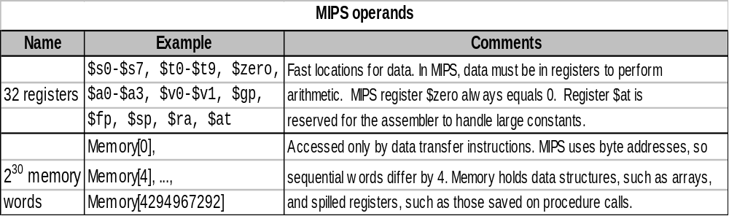
To summarize:
H.C. TD5102

Slide 24
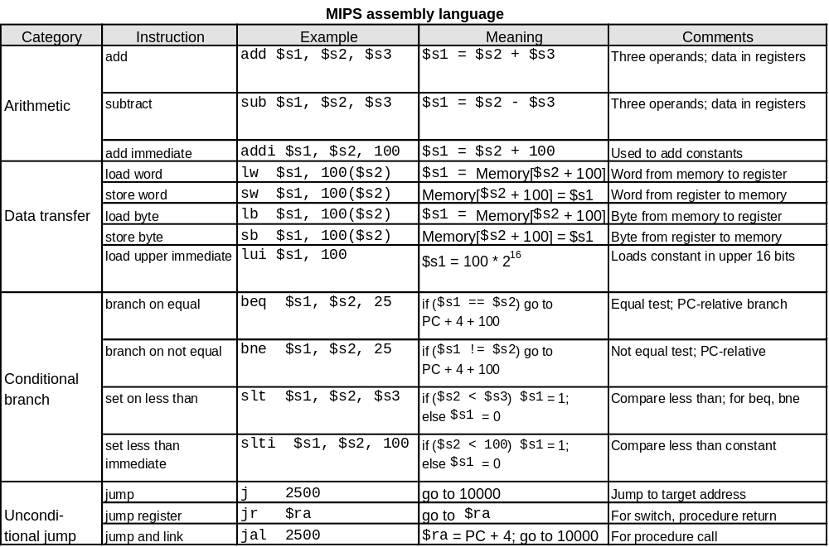
To summarize:
H.C. TD5102

Slide 25
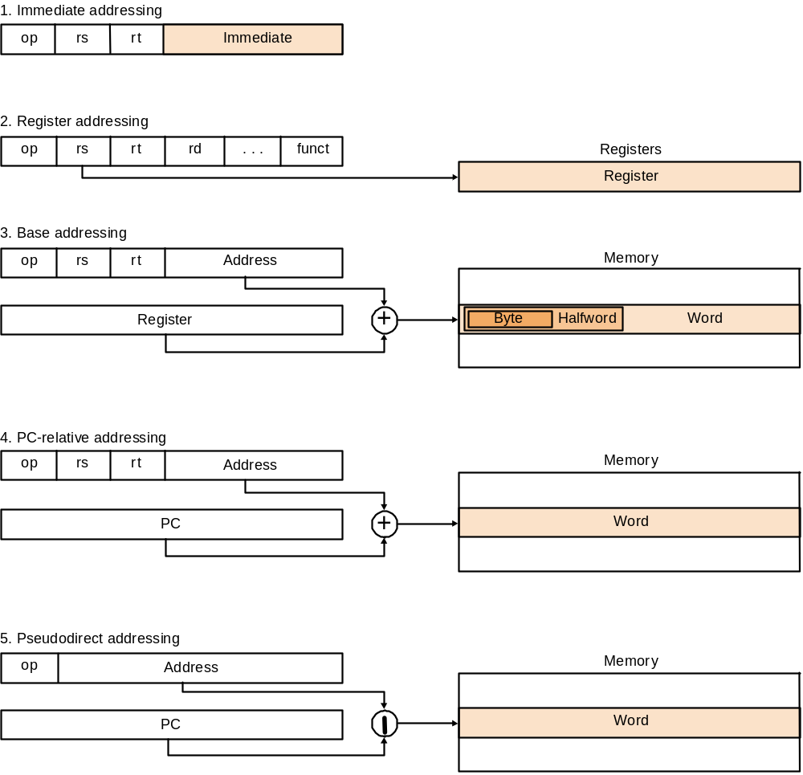
MIPS addressing modes summary
H.C. TD5102

Slide 26
Other Issues
Things not yet covered:
  support for procedures
  linkers, loaders, memory layout
  stacks, frames, recursion
  manipulating strings and pointers
  interrupts and exceptions
  system calls and conventions
We've focused on architectural issues
  basics of MIPS assembly language and machine code
  we’ll build a processor to execute these instructions
H.C. TD5102

Slide 27

Our First C Example
Can we figure out the code?
swap(int v[], int k);
{ int temp;
temp = v[k]
v[k] = v[k+1];
v[k+1] = temp;
}
swap:
muli $2 , $5, 4
add $2 , $4, $2
lw $15, 0($2)
lw $16, 4($2)
sw $16, 0($2)
sw $15, 4($2)
jr $31
Explanation:
index k : $5
base address of v: $4
address of v[k] is $4 + 4.$5
H.C. TD5102

Slide 28
MIPS
Instruction Set Architecture
Courtesy: Henk Corporaal
http://www.ics.ele.tue.nl/~heco/courses/EmbSystems
Technical University Eindhoven
DTI / NUS Singapore

